Slide 1
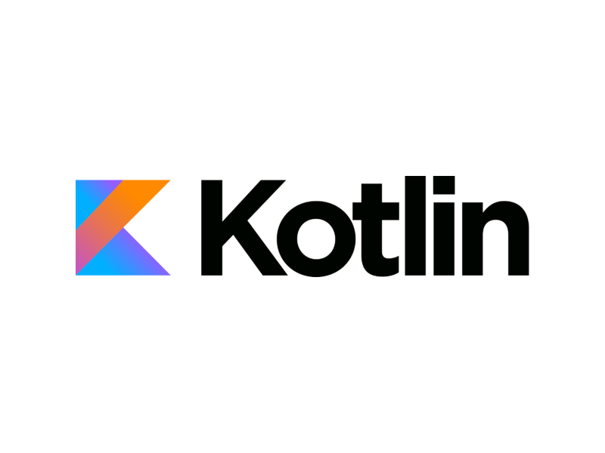

Android App Development with Kotlin
The Future of Android apps

Slide 2

Introduction
Kotlin is a general-purpose programming language developed by JetBrains, that has built world-class IDEs like IntelliJ IDEA, PhpStorm, etc. ...
Kotlin is sponsored by Google, announced as one of the official languages for Android Development in 2017.
Kotlin is mostly used by Android app developers.
It is an open source language
Kotlin used the Java programming language for its initial implementation

Slide 3
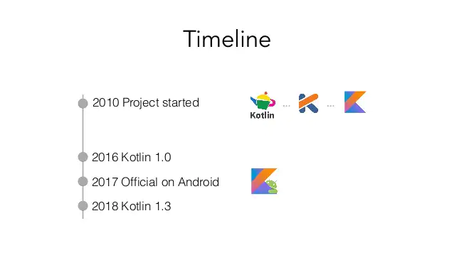
History
In 2010, JetBrains started to work on Project Kotlin, a new language for the JVM. The name comes from Kotlin Island. Kotlin was released on 15 February 2016. This is considered to be the first officially stable release.
Kotlin is sponsored by Google, announced as one of the official languages for Android Development in 2017.

Slide 4
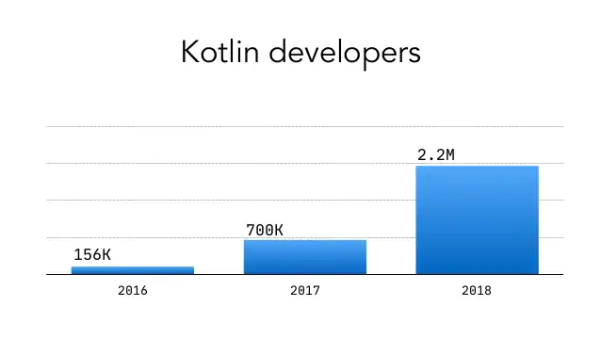
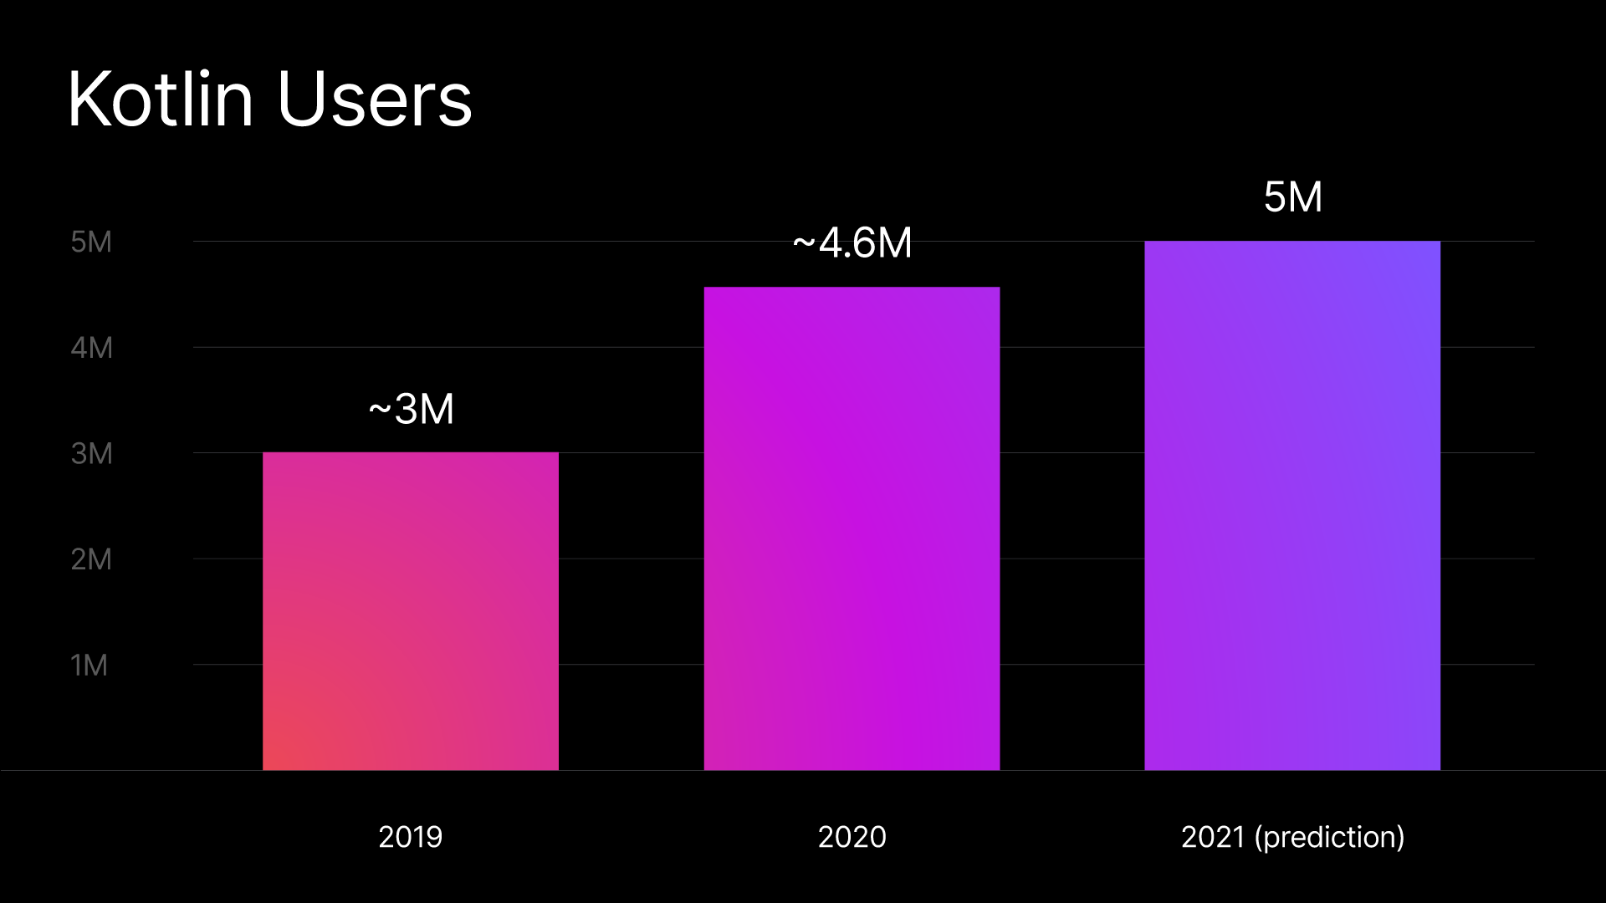
Stats of Kotlin:

Slide 5
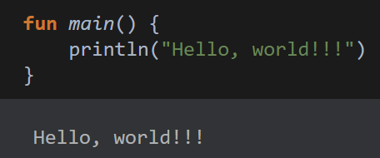
Working
When targeting the JVM, Kotlin produces Java compatible bytecode.
When targeting JavaScript, Kotlin transpiles to ES5 and generates code.
Sample Kotlin Code:

Slide 6
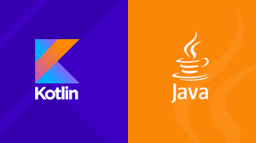
Advantages
Kotlin allows writing less code.
Kotlin is fully compatible with Java.
It’s easier to maintain.
Kotlin can be used for Android apps, serverside apps.
You can have Java and Kotlin code in same project.
With IDEs such as Android Studio, Intellij Idea Java code can be easily converted into kotlin and kotlin code can be converted into java.
Kotlin has many language features to help you to avoid common programming mistakes such as null pointer exceptions. Android apps that contain Kotlin code are 20% less likely to crash
Android apps which are written in kotlin are more likely lightweight.

Slide 7

Disadvantages
Different from Java: Though Kotlin and Java have too many same things but still, there are some differences too. App developers just can’t make the switch if they have knowledge about Kotlin.
Limited sources to learn.
Fluctuating compilation speed: In some cases, Kotlin is faster than Java. But still, we should remember that Java is the winner when it comes to clean builds.

Slide 8
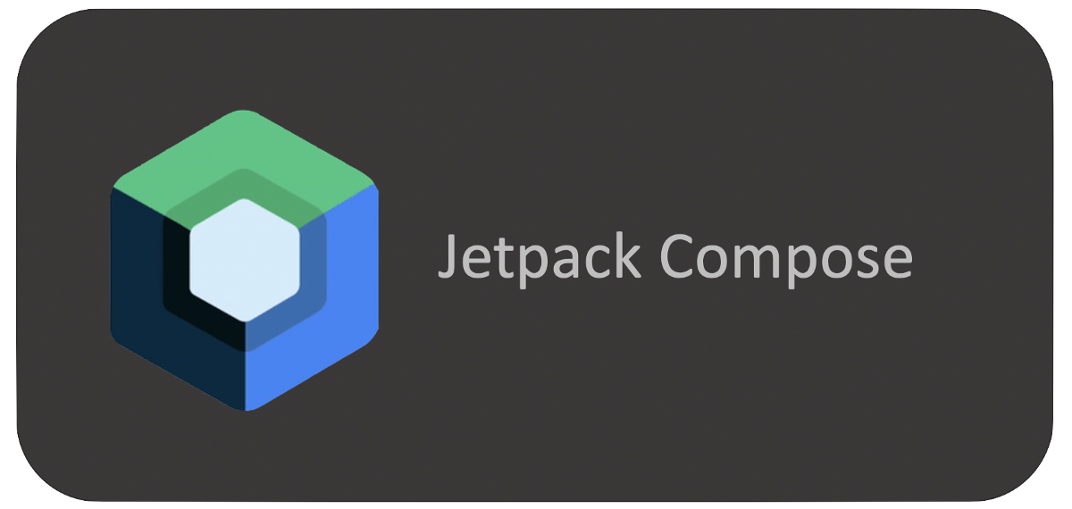
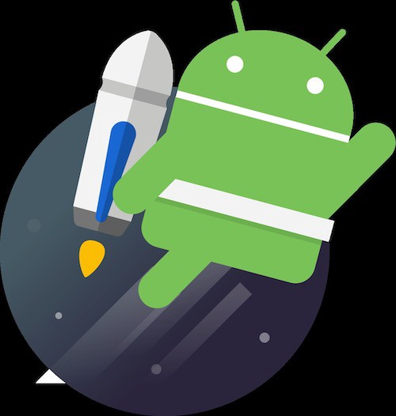
Advantages:
Jetpack Compose in Kotlin: The expectations around UI development have grown. To address the technical challenges of creating a polished UI quickly and efficiently Kotlin has introduced Jetpack Compose, a modern UI toolkit that sets app developers up for success in this new landscape.
It simplifies and accelerates UI development on Android bringing your apps to life with less code, powerful tools.
It makes building Android UI faster and easier
No need of XML layout when you use compose activity.

Slide 9
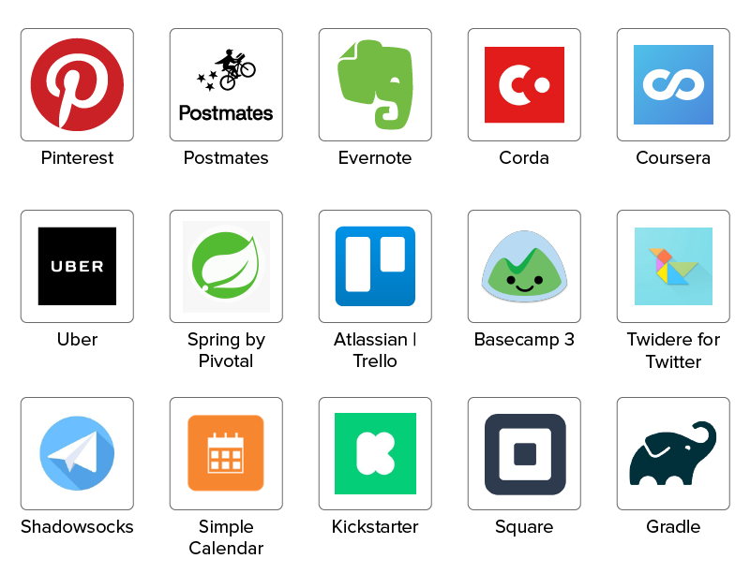
Top apps using Kotlin

Slide 10
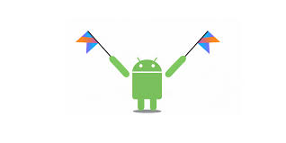
Since Google announced Kotlin as a one of the official languages for Android development, core Android App developers has started to switch to Kotlin.
Companies are rewriting their code in the Kotlin language.
JetBrains is introducing good features in Kotlin and they are not planning to introduce same features in the Java. So Kotlin is future for the Android apps.

